Slide 1

SALES ANALYSIS USING MACHINE LEARNING AND IVR SYSTEM

Slide 2

About The company
“ Glocal Digital Pvt Ltd. is a progressive start up intended to deliver the products with resource limited market value and enrich our customers with value added services. It is registered under Act-14A. It is an official premium partner of Canon India Pvt Ltd. Glocal also deals with many other products from Casio etc. “

Slide 3

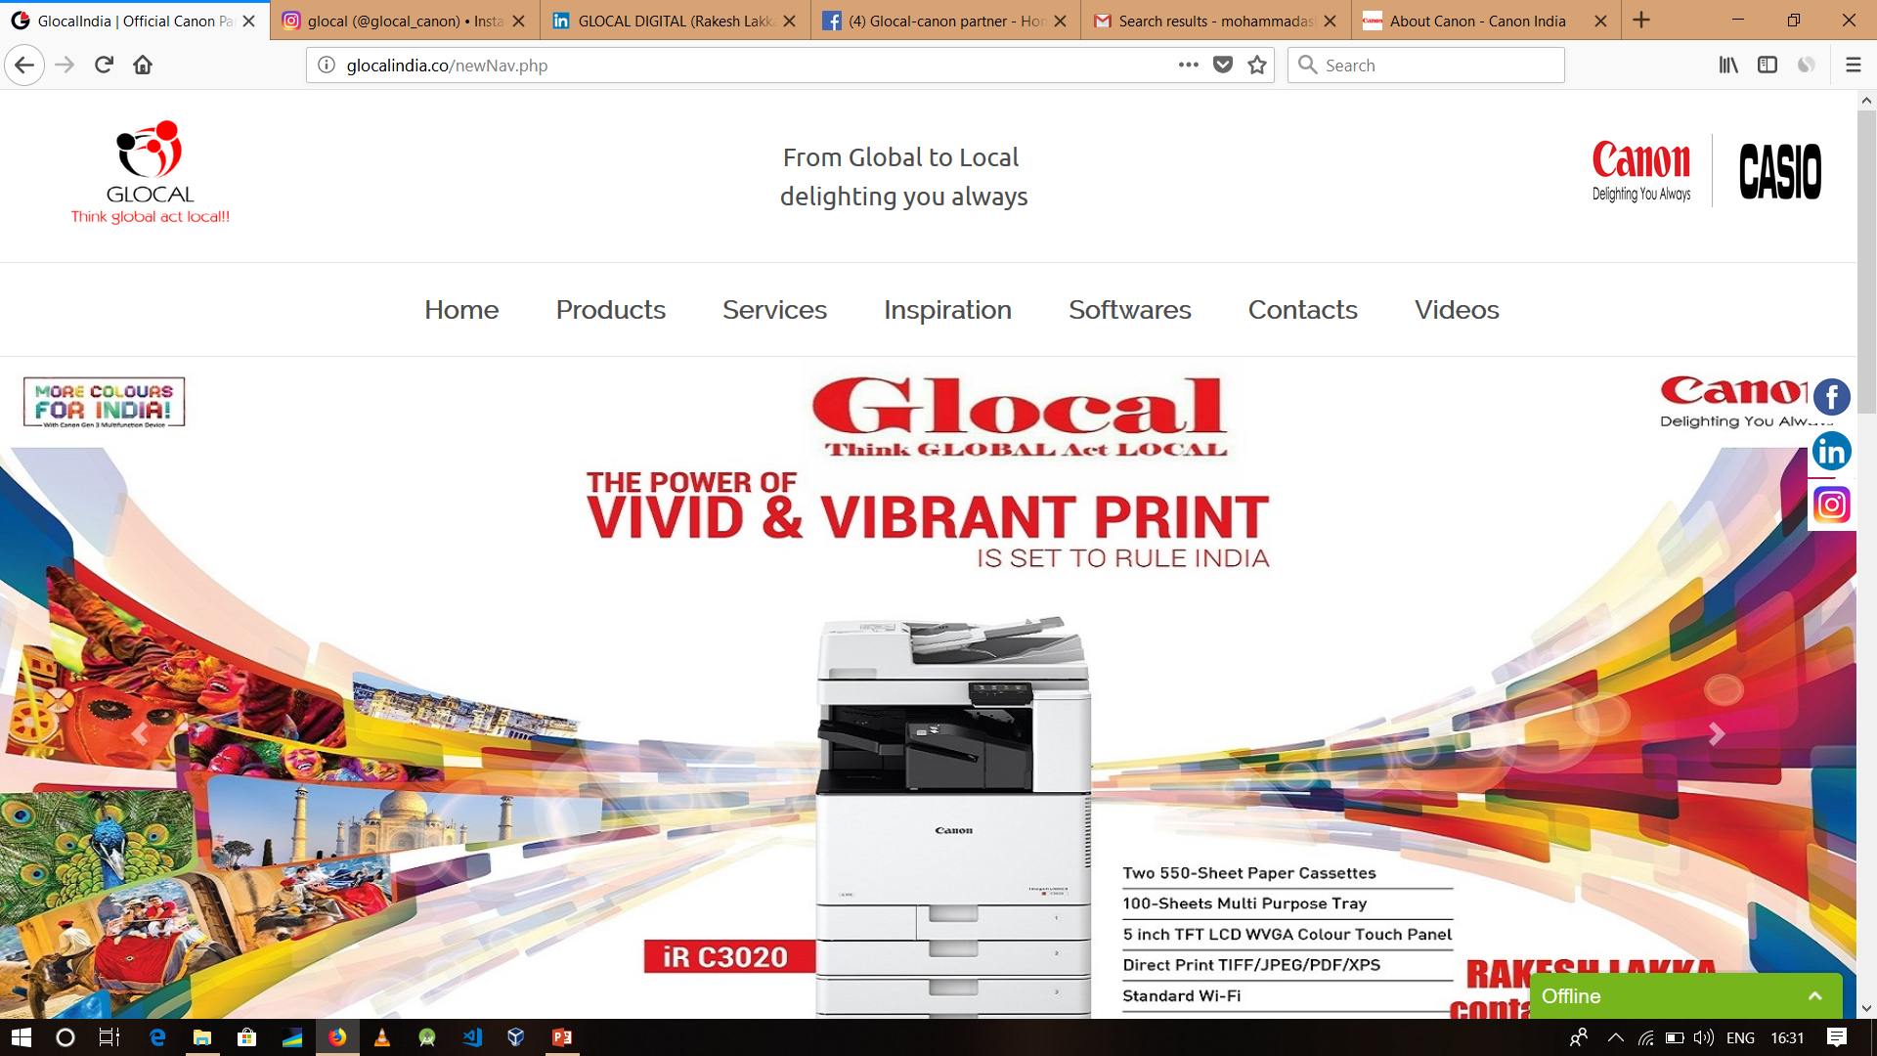
Official Website of glocal

Slide 4
BUSINESS FUNCTIONS OF GLOCAL
Business Strategy
Sales Management for B2C & B2B
Direct Sales Operation in Enterprise
Customer Relationship Management
Business Outsourcing
Managed Print Services
Top Level Networking & Solutions

Slide 5

#?: WHAT IS
OUR PROBLEM STATEMENT

Slide 6
“ To obtain a new methodology to inhabitant the sales industry and classify the calls(sales) into good, bad and neutral based on sentiment of that text. To replace the traditional calling system with Interactive voice response system developed using Text to Speech synthesis. “

Slide 7
Technologies USED
Python Scripting
Natural Language Processing
IBM Watson Audio-to-Text
Google Cloud API

Slide 8

“ We have just started addressing this problem statement “

Slide 9



Glimpse Of Our Project
1)Conversion Phase

Slide 10
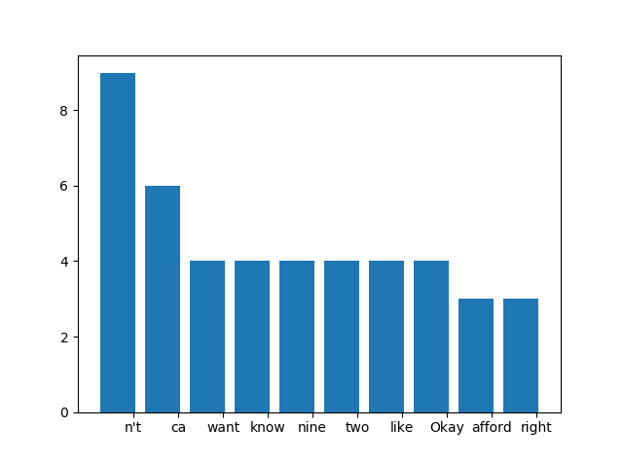
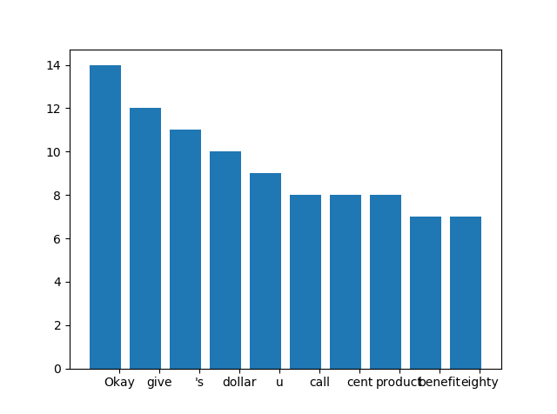
Analysis Phase

Slide 11
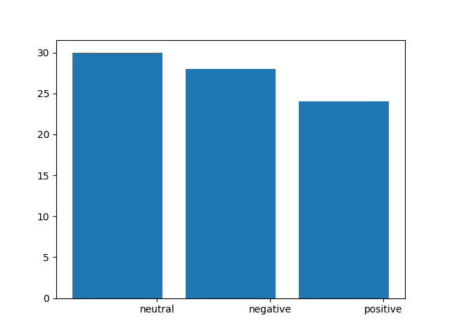
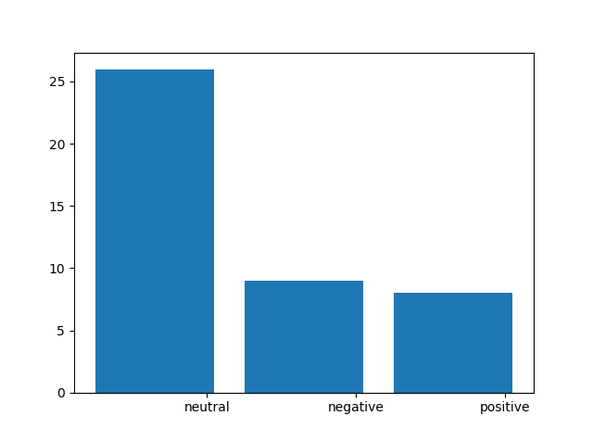
Sample Results Generated

Slide 12


Project by
B. Sushma Reddy (15311A1209)
G. Varshitha (15311A1207)
K. Sai Teja (15311A1211)
Md. Aslam Parvez (15311A1228)
U. Vinod (15311A1231)

